Slide 1
Cure Coders
Presents MyCareMap
AI4Purpose Hackathon ‘24

Slide 2
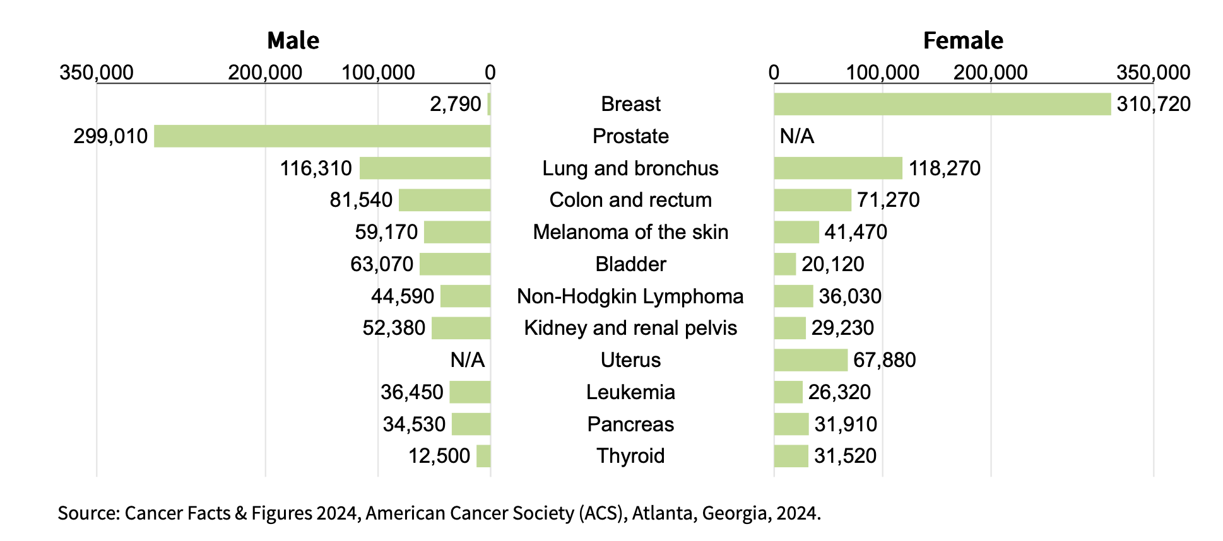
Problem
Number of people affected by Breast cancer (Annual)
Source: Cancer Facts & Figures 2024, American Cancer Society (ACS), Atlanta, Georgia, 2024.

Slide 3
Problem
Cancer knowledge changes rapidly, so much of the historical treatment plans are quickly outdated
There are numerous variables so there isn’t much history available for any given patient’s specific circumstance
AI give the possibility find the optimal treatment plan despite the limitation in the data

Slide 4
Problem
Doctors primarily based treatment plans on clinical factors (Genetic profiles, treatment history, X-rays, MRIs, CT, PET scans, etc)
Lifestyle factors like diet, stress management, and mindfulness are not consistently integrated
There is a lack of clear, standardized guidelines on how non-medical factors influence recovery
Notes:
https://link.springer.com/chapter/10.1007/978-981-99-0377-1_10
https://link.springer.com/article/10.1007/s10844-020-00633-6?fromPaywallRec=false

Slide 5
Where MyCareMap Steps In
Current Treatment Map
New Treatment Map
Detection
Detection
Doctor’s Plan
AI powdered Doctor’s Plan
Trial and Error
Quicker Changes in Treatment
Recovery/Treat-ment result
Recovery/Treatment result

Slide 6
Basic idea
Holistic approach
→Integrate both clinical data (e.g., genetic profiles, treatment history, etc.), and psychosocial and physical profiles (patient preferences, mental health, and emotional support needs) → provide customized treatment and wellness plans.

Slide 7
Solution Framework
Input
Clinical data: stage of cancer, area, location + Psychological & physical data
Process: Random Forest Classifier that classifies the patient to a basic treatment plan, by going through the different branches of chemo, surgery and respective treatment effectiveness.
For the doctor: A holistic treatment plan
Models
Output

Slide 8
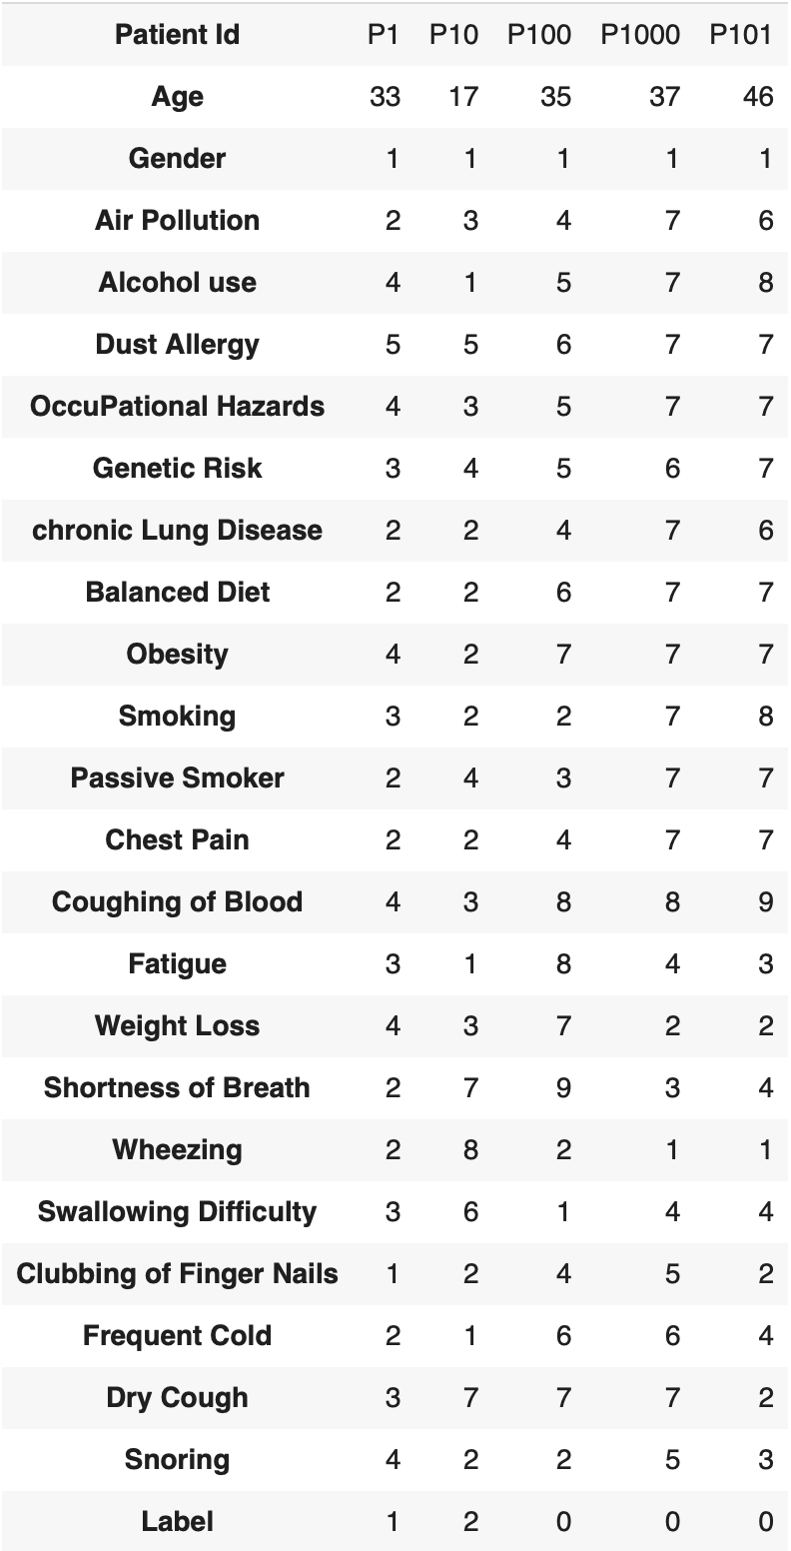
Mock Data
treatment
Source: https://www.kaggle.com/datasets/rishidamarla/cancer-patients-data

Slide 9
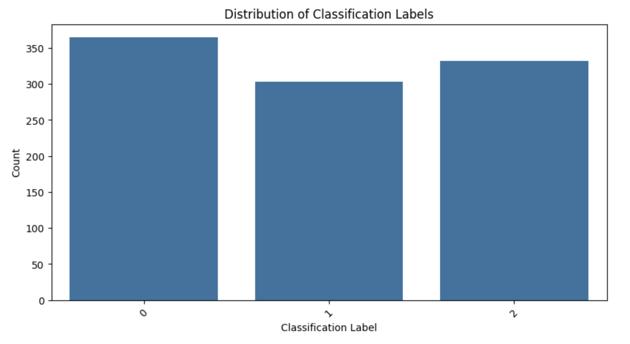
Class Bias
Notebook link

Slide 10
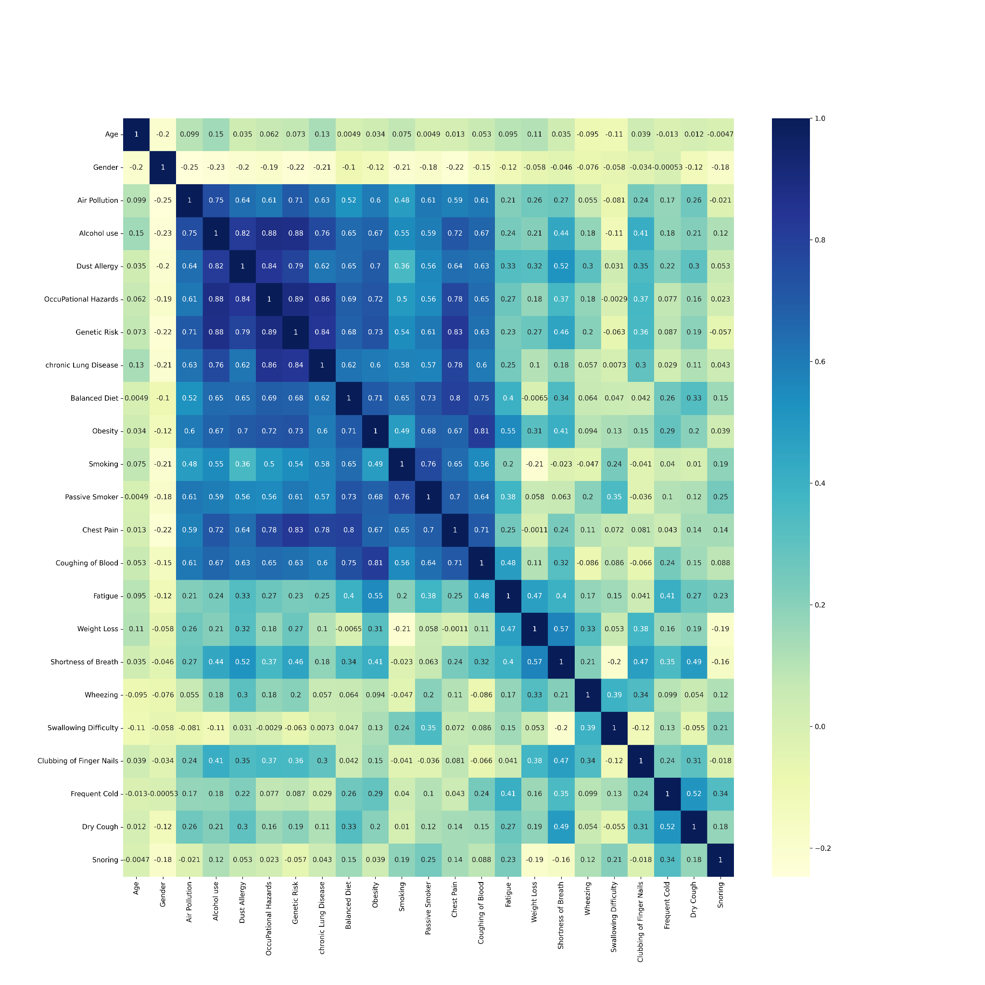
Correlation
Notebook link

Slide 11
Models
Recommendation system
Generating a list of items based on a user's preferences and information needs.
In the context of cancer treatment, the items are drugs, nutrition, mental and physical treatment, and the users are cancer cell lines.
Techniques:
1) Collaborative-filtering: based on past interactions recorded between users and items in order to produce new recommendations. These interactions are stored in the so-called “user-item interactions matrix”
2) Content-based methods: content based approaches use additional information about users and/or items.

Slide 12
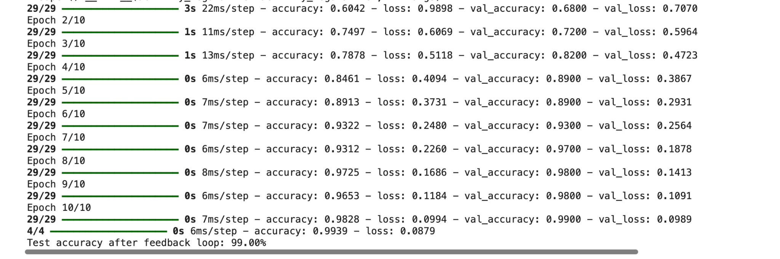
Models
Without feedback loop
Classifiers
ML models (random forests, gradient boosting, etc.) can continuously adjust the recommendations based on feedback loops → system is adaptive to patient needs​.
Notebook link

Slide 13
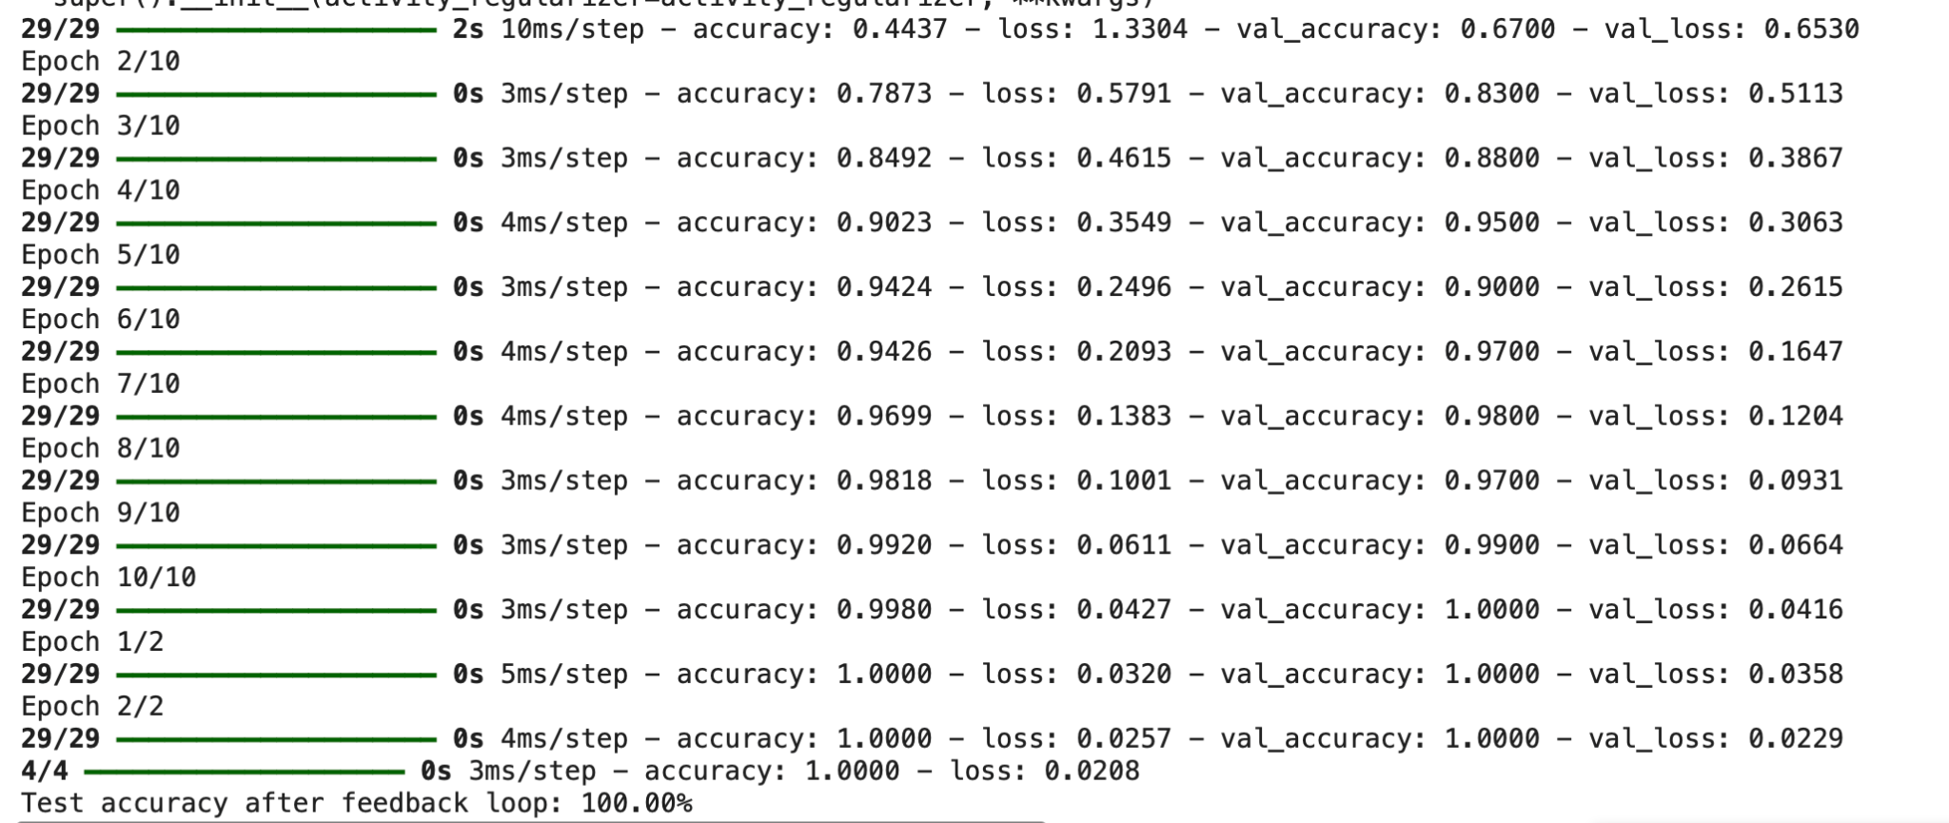
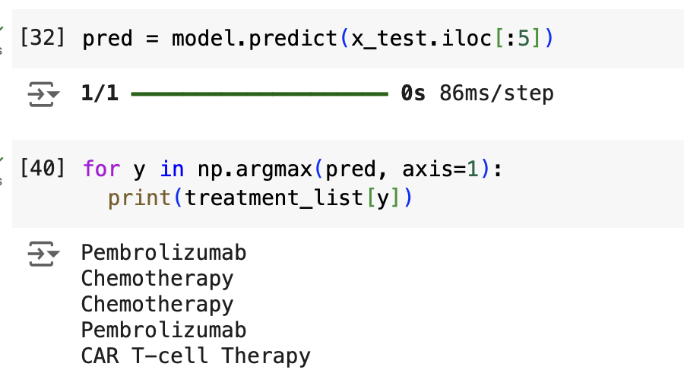
Models
Using feedback loop
Notebook link

Slide 14
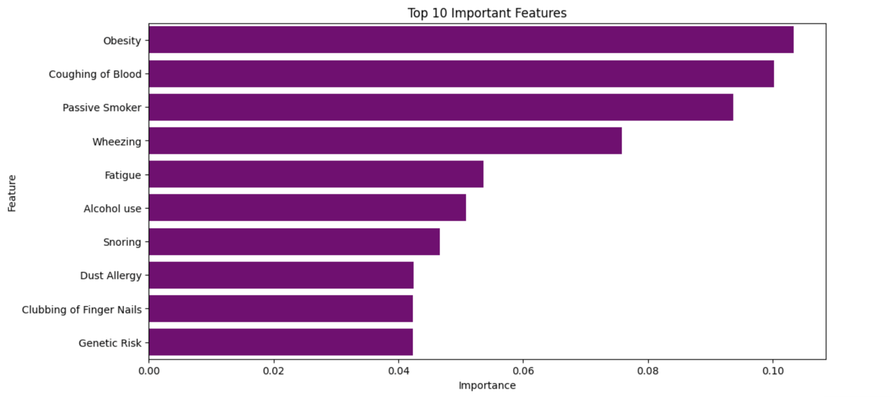
Feature Importance
Notebook link

Slide 15
Advantages
Adaptive AI: ML models (random forests, gradient boosting) adjust treatment based on patient feedback, enhancing responsiveness.
Comprehensive Care: Recommends not only medical treatments but also nutrition, mental health, and wellness support.
AI-Driven Decisions: Predicts optimal treatment paths, allowing quicker, data-informed choices.
Scalable Potential: Adaptable for other cancer types and chronic illnesses.
Holistic Integration: When combined clinical, psychosocial, and lifestyle data, has the potential for a fully personalized approach.
Notes:
Confidentiality Risks: As health apps collect sensitive information about users, there is always the potential risk of data breaches or improper handling of patient data. Users may feel hesitant to fully disclose personal information about their health if privacy protections are not transparent or robust​

Slide 16
Limitations
Data privacy (sensitive health data)
Lack of data on psychological and physical treatment for training data
More Research Needed for Long-Term Effects of wellness practices
Siloed Research across oncology, nutrition, and mental health
Interpretability and reliability of models → need doctors judgements + feedback to finalize a treatment plan for patients
Notes:
Confidentiality Risks: As health apps collect sensitive information about users, there is always the potential risk of data breaches or improper handling of patient data. Users may feel hesitant to fully disclose personal information about their health if privacy protections are not transparent or robust​

Slide 17
Competitors
Example of one company:
Certis Oncology: AI/ML platform that identifies complex, gene expression signatures that correlate with drug response
Other companies exist that create AI models/tools thatl research the effect of certain drugs in oncology, or predicting results of certain drugs, others that work on a certain treatment drug and its effectiveness, but not the actual treatment plan.
Link to other companies in notes
Notes:
https://info.certisoncology.com/certisai-predictive-oncology-intelligence?utm_term=artificial%20intelligence%20in%20radiation%20oncology&utm_campaign=AI+-+Predictive&utm_source=adwords&utm_medium=ppc&hsa_acc=2025132084&hsa_cam=21838013425&hsa_grp=170663399033&hsa_ad=718166474624&hsa_src=g&hsa_tgt=kwd-1141680950599&hsa_kw=artificial%20intelligence%20in%20radiation%20oncology&hsa_mt=b&hsa_net=adwords&hsa_ver=3&gad_source=1&gbraid=0AAAAACTESrnVsCnOmCgjxPrY_AN4mNvP6&gclid=Cj0KCQiA88a5BhDPARIsAFj595h1VPwjJrkEFLR6yH4syBEQH1R7HkBFaSV2MTCdcmlyUQjlhEON3bsaAv4mEALw_wcB
https://www.biopharmatrend.com/post/698-how-artificial-intelligence-is-reshaping-the-landscape-of-personalized-cancer-treatment/#:~:text=Evaxion%20Biotech%20(NASDAQ%3A%20EVAX),bacterial%20diseases%2C%20and%20viral%20infections.

Slide 18
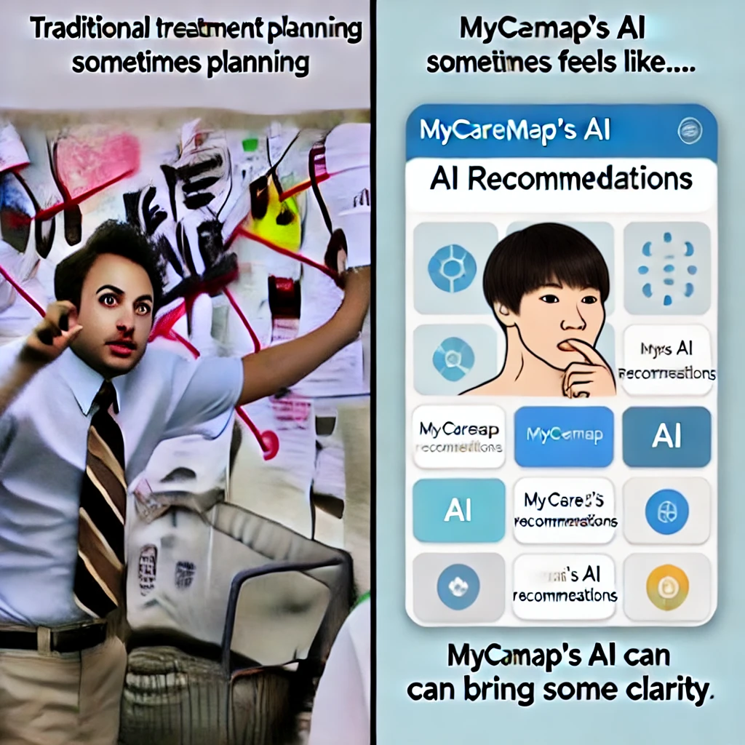
Why we should win the prize??
Recommendation system allows for combining all the available cancer profiles across the country.
We literally increased the efficiency of curing cancer, how impressive is that!

Slide 19
Our team & Backgrounds
Brian Mann: 8 years + Work experience in Healthcare Analytics, Education: Chemical Engineering
Jayant Dabas: 2 years Work experience as Software Engineer, Education: Computer Science
Vy Mai: 2 years Work experience Data Analytics in Insurance (Financial Services), Education: Quantitative Economics and Anthropology
Maitri Patel: 2 years work experience in Data Analyst, Education: Computer Science
Jovita Gandhi: 2 years work experience in Finance and Consultancy, Education: Economics and Finance

Slide 20
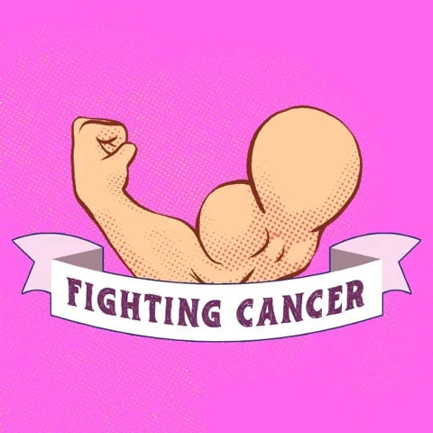

Thank You!

Slide 21

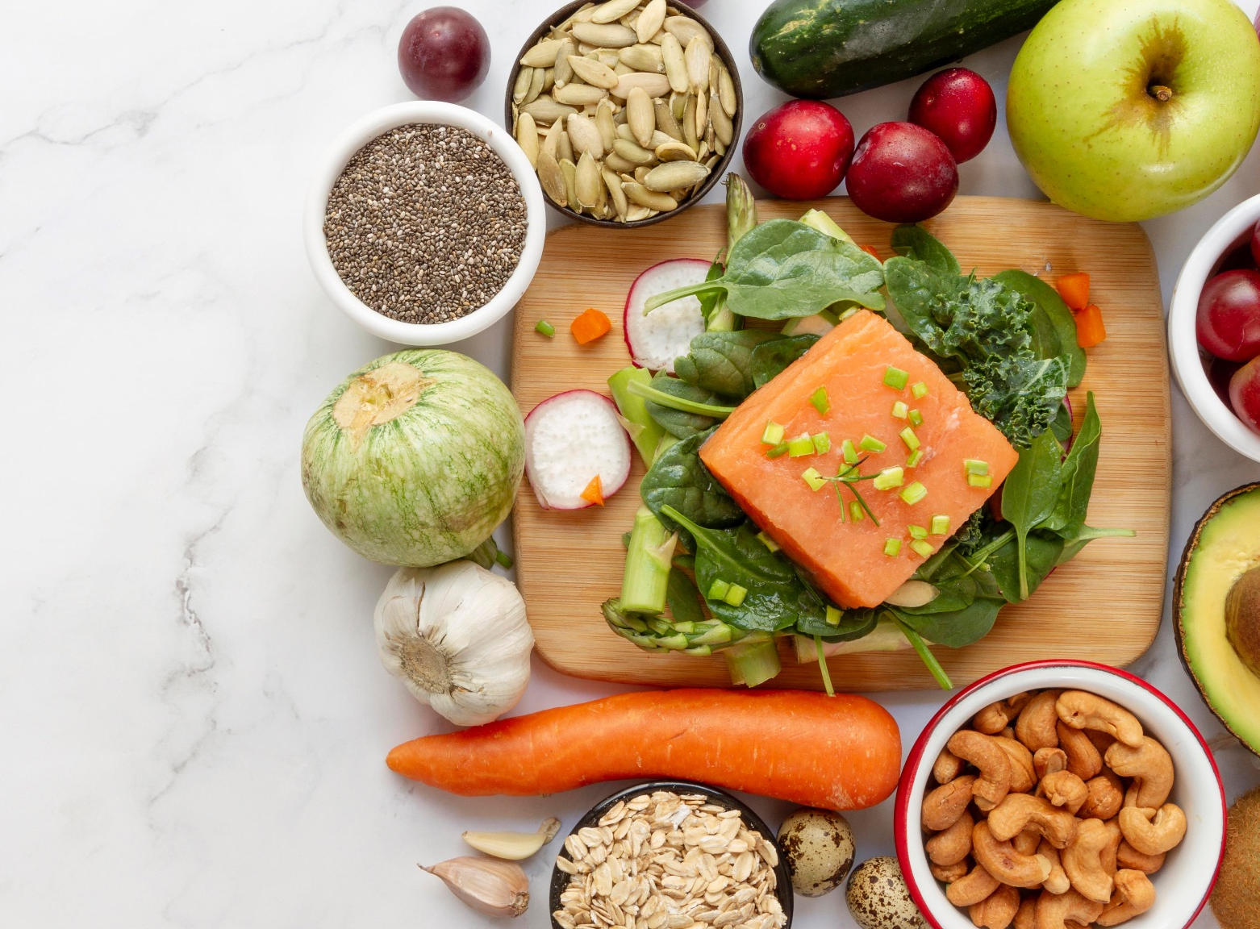

Problem
Treatments that are under researched, but historically have been used in older cultures
Ayurveda
Nutrition
Yoga

Slide 22
Solutions
Integrative Oncology Programs:
combine conventional cancer treatments with complementary therapies like acupuncture, massage therapy, nutrition counseling, and meditation
- Market: US
- Research done at cancer centers: MD Anderson Cancer Center, Memorial Sloan Kettering Cancer Center, and Cleveland Clinic
- Cancer treatment apps & platforms: HealthJourneys and My Cancer Coach

Slide 23
Approach
Use Data detailed Above:
Run data through our recommendation system
Classifier like approach, add discriminator (use GANs) if

Slide 24
Data Sourcing
Cancer Data
Nutrition data
“This person needs a protein rich diet three days before Chemo”
Patient data
Patient history

